Slide 1
Point Pattern Analysis

Slide 2
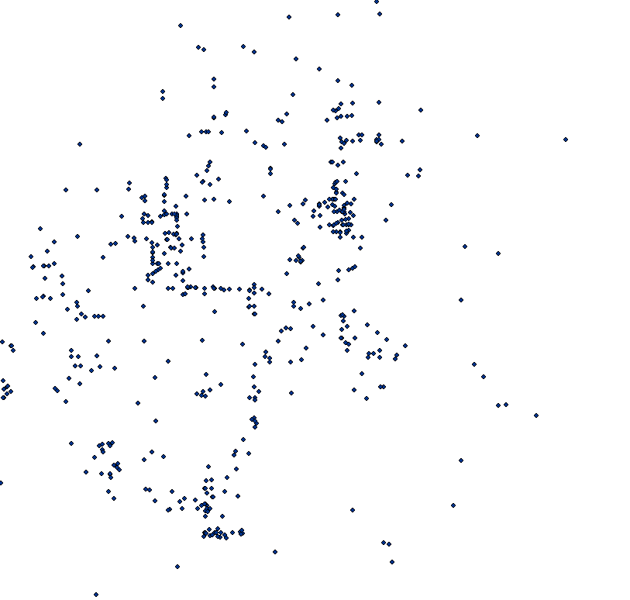
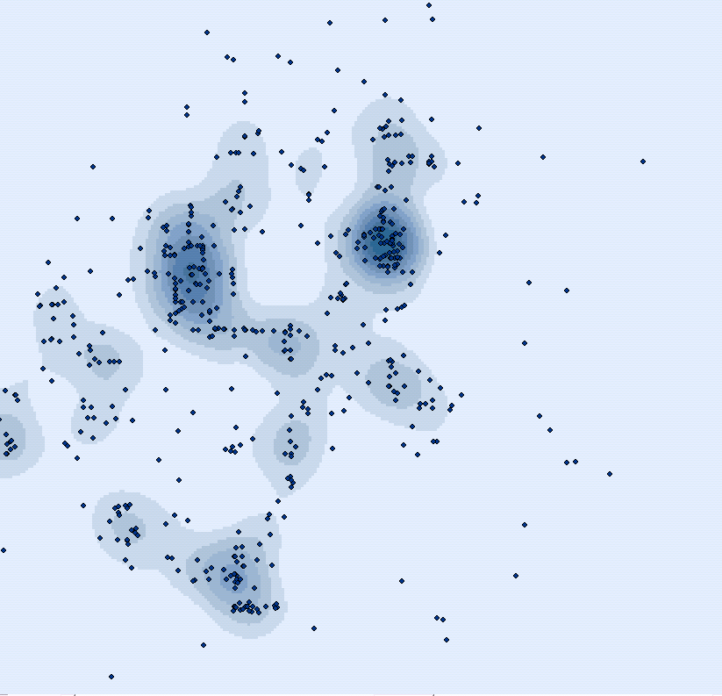
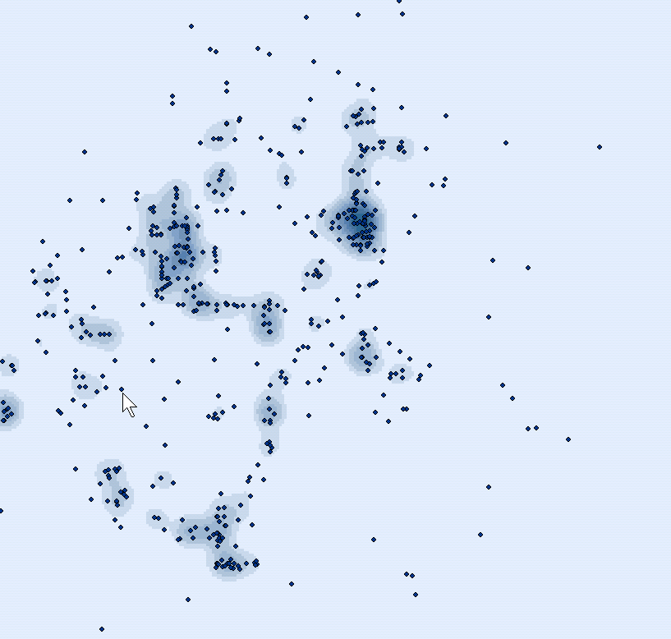
Density Kernel Estimation
commonly used to “visually enhance” a point pattern
Is an example of “exploratory spatial data analysis” (ESDA)
Kernel=10,000
Kernel=5,000

Slide 3
Density Kernel Estimation
Radii surrounding each point are based on a quadratic formula with the highest value of observations assumed to be at the center (the point location), then tapering to zero at the radius distance.
Kernel density calculates a "magnitude per search radius" from a point using a kernel function to fit a smoothly tapered surface to each point.
Note that while density maps can show where clusters exist in your data, they do not indicate whether there are statistically significant differences between clusters.

Slide 4
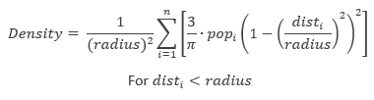
Density Kernel Estimation
Formula:
Pop is equal to one unless we want to weight results to a column value
We choose the radius
Dist is the distance from a point in a grid cell and any points within the radius…

Slide 5
Types of Distribution
Three general patterns:
Random any point is equally likely to occur at any location and the position of any point is not affected by the position of any other point. There is no apparent ordering of the distribution
Uniform every point is as far from all of its neighbors as possible
Clustered many points are concentrated close together, and large areas that contain very few, if any, points

Slide 6
Quadrat Analysis
Based on a measure derived from data obtained after a uniform grid network is drawn over a map of the distribution of interest
The frequency count, the number of points occurring within each quadrat is recorded first
These data are then used to compute a measure called the variance
The variance compares the number of points in each grid cell with the average number of points over all of the cells
The variance of the distribution is compared to the characteristics of a random distribution

Slide 7
Quadrats
RANDOM
UNIFORM
CLUSTERED

Slide 8
Quadrat Calculation
Mean = # of points / # of quadrats
Notes:
The variance to mean ratio indicates the type of point pattern: if it’s close to one it is random. If it’s close to zero, it’s uniform. And if it is above one then it is more clustered.

Slide 9
Quadrat Calculation Results
A random distribution would indicate that that the variance and mean are the same. Therefore, we would expect a variance-mean ratio around 1
Values other than 1 would indicate a non-random distribution.

Slide 10
Weakness of Quadrat Analysis
Quadrat size and orientation
If the quadrats are too small, they may contain only a couple of points. If they are too large, they may contain too many points – a scale issue.
Test different sizes to determine the effects of each test on the results

Slide 11
Nearest-Neighbor Analysis
Unlike quadrat analysis, uses distances between points as its basis.
The mean of the distance observed between each point and its nearest neighbor is compared with the expected mean distance that would occur if the distribution were random

Slide 12
Nearest-Neighbor Analysis
RANDOM
UNIFORM
CLUSTERED

Slide 13
Nearest-Neighbor Calculation
Clustered
Patterns are
Closer to 0 on R
Notes:
The Average Nearest Neighbor tool measures the distance between each feature centroid and its nearest neighbor's centroid location. It then averages all these nearest neighbor distances.
If the average distance is less than the average for a hypothetical random distribution, the distribution of the features being analyzed is considered clustered. If the average distance is greater than a hypothetical random distribution, the features are considered dispersed.
The average nearest neighbor ratio is calculated as the observed average distance divided by the expected average distance (with expected average distance being based on a hypothetical random distribution with the same number of features covering the same total area).
Random patterns are closer to 1 on R
Clustered Patterns are Closer to 0 on R
Dispersed patterns are above 1 on R

Slide 14
Advantages of Nearest Neighbor over Quadrat Analysis
No quadrat size problem to be concerned with
Takes distance into account
Problems:
Related to the entire boundary size
Must consider how to measure the boundary
Arbitrary or some natural boundary (need theory)
May not consider a possible adjacent boundary

Slide 15
Is it clustered?

